Slide 1


Sign Language Recognition System
GUIDED BY DR. ARPIT JAIN

Slide 2
GROUP MEMBERS
01
PRITESH BHATIYA
02
HARSH BHATT
03
ANKIT CHAVDA
04
BHAVIN PADIYA
05
MIRAL SAVERA
202200719010009
202200719010011
202200719010020
202200719010063
202200719010075

Slide 3
PROJECT PROFILE
Speech impaired people use hand signs and gestures to communicate. Normal people face difficulty in understanding their language. Hence there is a need of system which recognizes the different signs, gestures and conveys the information to normal people. It bridges the gap between physically challenged people and normal people

Slide 4
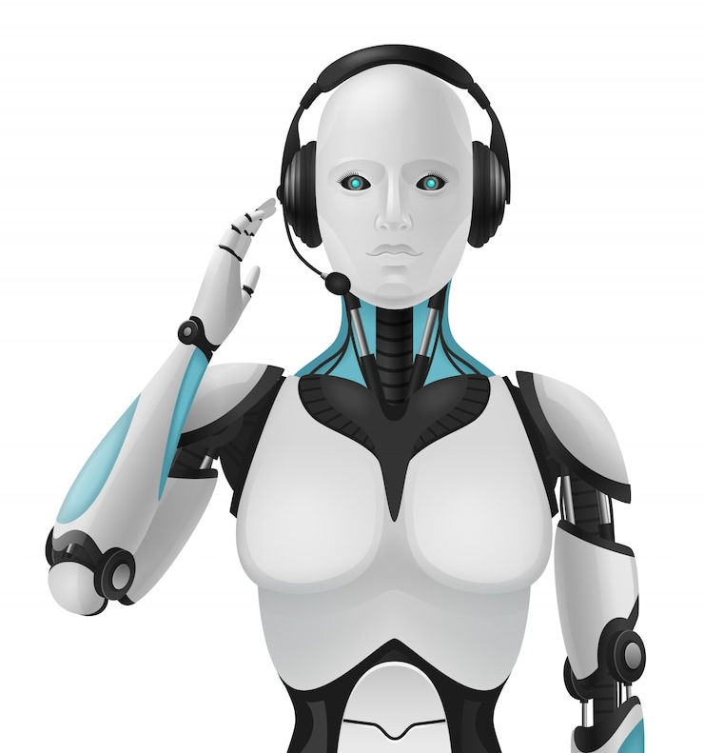
SYSTEM DESCRIPTION

Slide 5
INTRODUCTION
Sign Language is a form of communication used primarily by people hard of hearing or deaf.
A major issue with this convenient form of communication is the lack of knowledge of the language for the vast majority of the global population.
Just as any other language, learning Sign Language takes much time and efforts, discouraging to from being learned by the larger population
However, an evident solution to this issue is present in the world of Machine Learning and Image Detection.
Implementing predictive model technology to automatically classify Sign Language symbols can be used to create a form of real-time captioning for virtual conferences like Zoom meetings and other such things.

Slide 6
BENEFITS TO SOCIETY
Sign Language Recognition model have several benefits for society, especially for the deaf and hard-of-hearing communities. Here are few ways that these model can be beneficial :
Communication : with these models, individuals who use sign language can communicate more easily with those who don’t, breaking down communication barriers and fostering better understanding.
Accessibility : with these models, we can use sign language in various sectors like education, healthcare, and other essential services

Slide 7
BENEFITS TO SOCIETY
Inclusion : Sign language recognition system can help promote inclusion and diversity in society. By recognising sign language as a legitimate form of communication, these models help validate the deaf and hard-of-hearing community’s culture and language.
Employment : Sign language recognition models can also help improve job opportunities for deaf and hard-to-hearing individuals. By making it easier for employers to communicate with deaf and hard-to-hearing employees, these models can help remove communication barriers and create a more inclusive work environment.
Overalls, Sign language recognition models can have a positive impact on society by promoting communication, accessibility, inclusion, and employment opportunities for deaf and hard-to-hearing communities.

Slide 8
HARDWARE USED IN DEVELOPMENT
Ram :8GB/4GB
Processor: 2.23 GHZ I3/I5 Processor
OS: Windows 11, Windows 10 Other Window Operating System, Linux OS,Mac OS.
Hard Drive: 512 GB SSD/1 TB Hard Drive

Slide 9
SOFTWARE USED IN DEVELOPMENT
PROGRAMMING LANGUAGE : Python
MACHINE LEARNING LIBRARIES AND FRAMEWORKS : TensorFlow, Keras, numpy, Cvzone etc…
IMAGE PROCESSING OR COMPUTER VISION LIBRARIES : OpenCV
IDEs : PyCharm, or Visual Studio Code

Slide 10

MODULES & LIBRARIES

Slide 11
OpenCV : Open Source Computer Vision is a popular library for image and video processing. It can be used to read and process video frames, detect hand and body movements, and track hand positions.
TensorFlow : TensorFlow is a popular open-source library for machine learning. It can be used to train models for sign language recognition and to make predictions on new data.
Keras : Keras is also a high-level deep learning API that can be used to build and train models for sign language recognition.
Mediapipe : It can be used for hand tracking, pose estimation, face detection and more.
Cvzone: This is a Computer vision package that makes its easy to run Image processing and AI functions. At the core it uses OpenCV and Mediapipe libraries.

Slide 12

DATA DICTIONARY

Slide 13
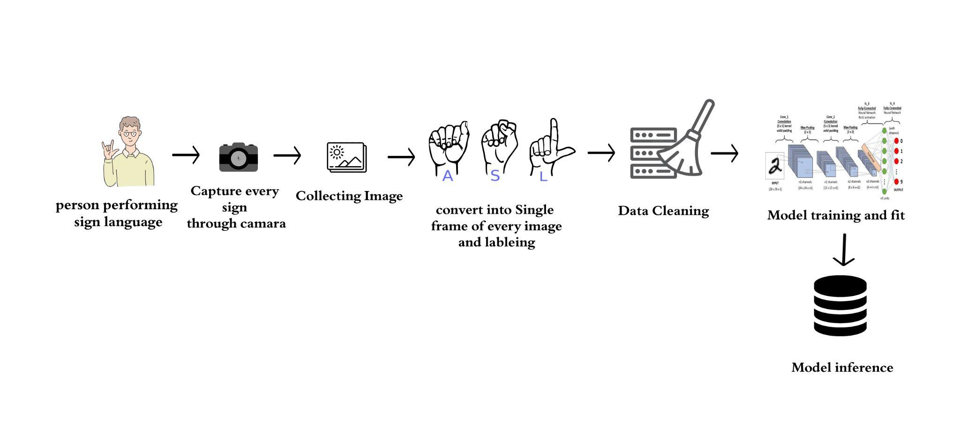
HOW TRAIN THE MODEL?

Slide 14
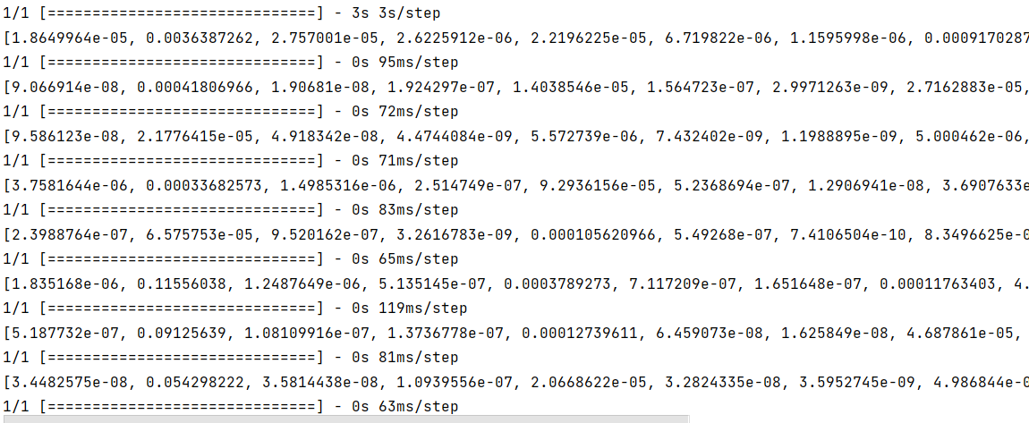
TRAINED DATA COORDINATES

Slide 15
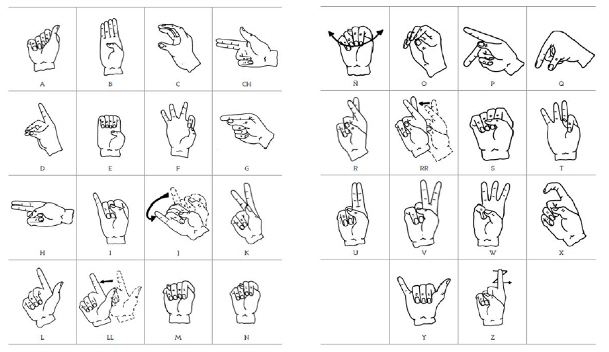
TRAINED DATA

Slide 16
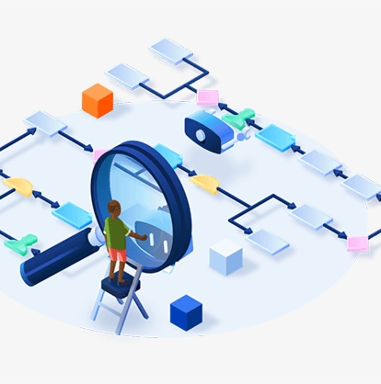
FLOW OF SYSTEM

Slide 17
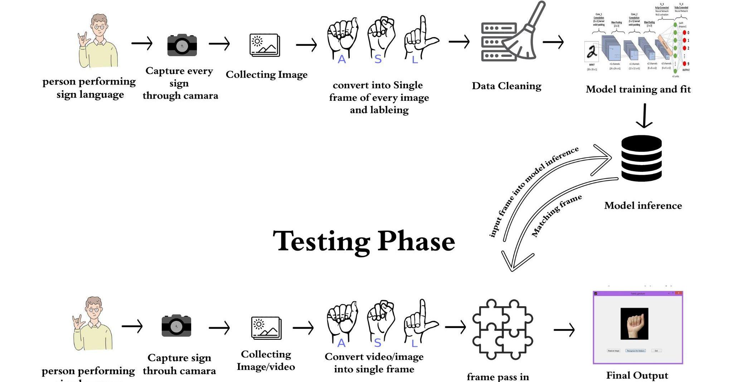

Slide 18
Collect and Preprocess Data : Collect video of data of sign language gesture from different angles and lighting conditions. Preprocess the data by resizing the frames and normalizing the pixel values.
Install and Import Mediapipe : Install the Mediapipe library and import necessary modules and functions.
Load the Sign Language Recognition : Load the pre-trained sign language recognition model from the MediaPipe Model Zoo. This model can be used to recognize hand gestures in real-time video data.
Initialize the Video Capture : Initialize the video capture using OpenCV library. This will enable you to read and process the frames from the video frames.

Slide 19
Process the Video Frames : Process each video frame using MediaPipe to detect the hand landmarks and extract relevant features such as hand position, orientation, and movement. This can be done using the ‘Hands’ module in MediaPipe.
Recognize the Sign Language Gesture : use the extracted features to recognize the sign language gesture using the pre-trained model. This can be done using ‘Classification’ module in MediaPipe.
Display the Results : Display the recognized sign language gesture on the video stream using OpenCV. You can also store results in database or use them for further analysis.

Slide 20
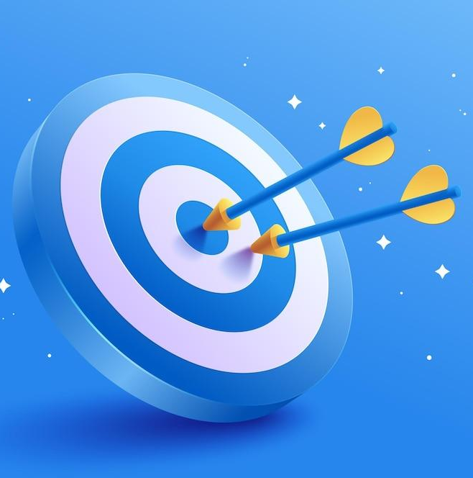
SYSTEM
INPUT - OUTPUT

Slide 21
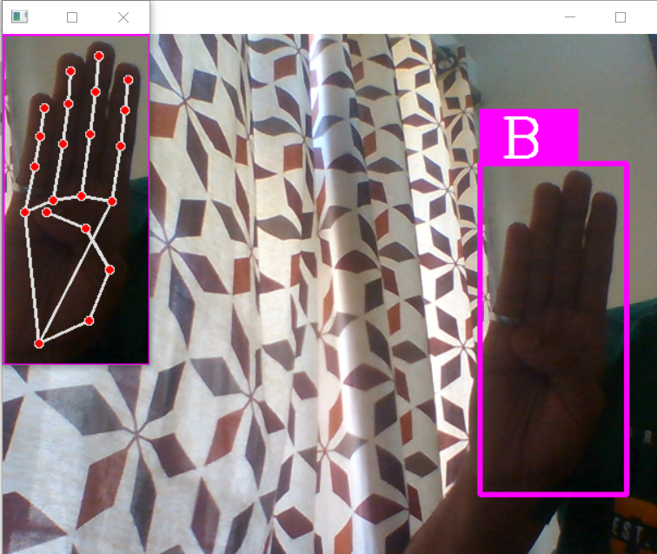
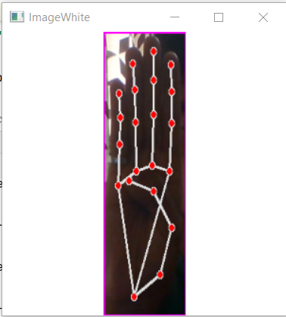
Output

Slide 22
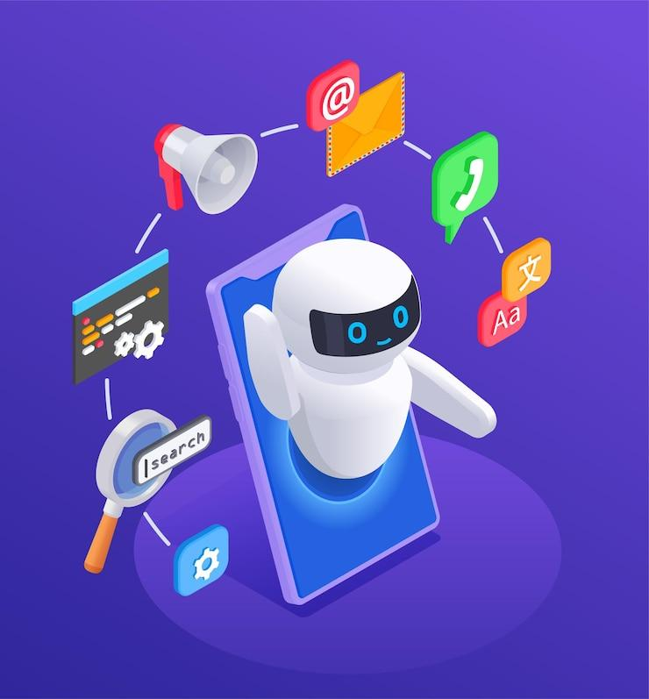
FEATURE ENHANCEMENT

Slide 23
VOICE
LANGUAGE TRANSLATE
SYSTEM IMPROVEMENT
We will enhance our system using voice output using system generated result.
We will improve our system with multiple language support.
We will enhance our system with fast performance.

Slide 24
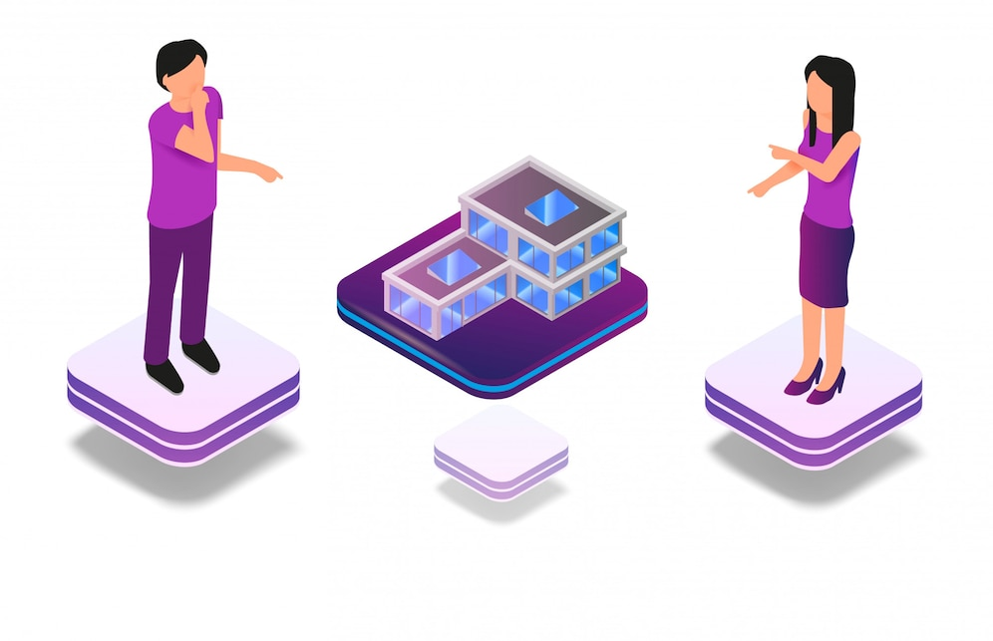
C0NCLUSION
While Sign Language Recognition has made significant progress in recent years. There are still challenges that need to be addressed.
These include the need for more accurate and reliable recognition models, the ability to recognize sign language gestures in real-world setting with varying lighting and background conditions, and the need for more extensive datasets for training and testing models.

Slide 25
THANK YOU

